Slide 1
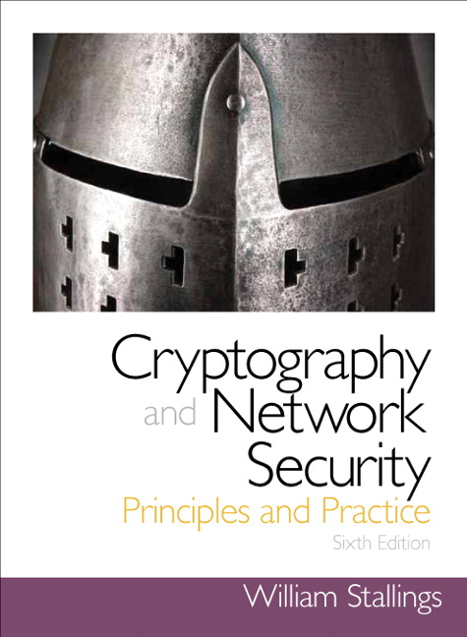
Cryptography and Network Security
Seventh Edition
by William Stallings
Notes:
Lecture slides prepared for “Cryptography and Network Security”, 7/e, by William Stallings, Chapter 7 – “Block Cipher Operation”.

Slide 2
Chapter 7
Block Cipher Operation
Notes:
This chapter continues our discussion of symmetric ciphers. We begin with the topic of
multiple encryption, looking in particular at the most widely used multiple-encryption
scheme: triple DES.
The chapter next turns to the subject of block cipher modes of operation. We
find that there are a number of different ways to apply a block cipher to plaintext, each
with its own advantages and particular applications.

Slide 3
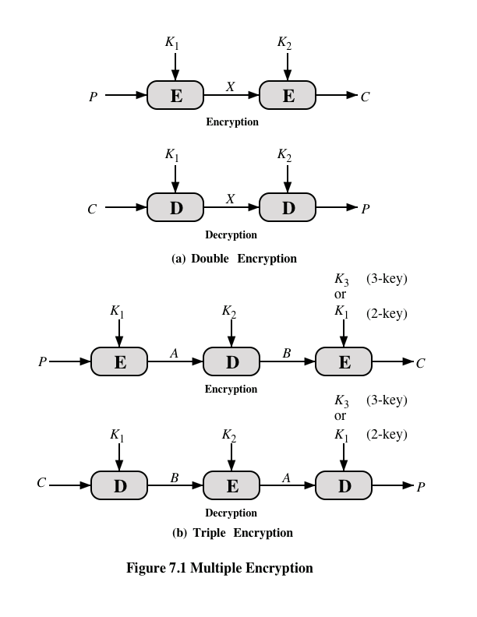
Notes:
Because of its vulnerability to brute-force attack, DES, once the most widely used
symmetric cipher, has been largely replaced by stronger encryption schemes. Two
approaches have been taken. One approach is to design a completely new algorithm
that is resistant to both cryptanalytic and brute-force attacks, of which AES
is a prime example. Another alternative, which preserves the existing investment in
software and equipment, is to use multiple encryption with DES and multiple keys.
We begin by examining the simplest example of this second alternative. We then
look at the widely accepted triple DES (3DES) algorithm.
The simplest form of multiple encryption has two encryption stages and two keys
(Figure 7.1a).
Given a plaintext P and two encryption keys K₁ and K₂ , ciphertext C
is generated as
C = E(K₂ , E(K₁ , P ))
Decryption requires that the keys be applied in reverse order:
P = D(K₁ , D(K₂ , C ))
For DES, this scheme apparently involves a key length of 56 * 2 = 112 bits, resulting
in a dramatic increase in cryptographic strength. But we need to examine the
algorithm more closely.
it is reasonable to assume that if DES is used twice with different keys, it
will produce one of the many mappings that are not defined by a single application
of DES. Although there was much supporting evidence for this assumption, it was
not until 1992 that the assumption was proven [CAMP92].

Slide 4
Meet-in-the-Middle Attack
The use of double DES results in a mapping that is not equivalent to a single DES encryption
The meet-in-the-middle attack algorithm will attack this scheme and does not depend on any particular property of DES but will work against any block encryption cipher
Notes:
Thus, the use of double DES results in a mapping
that is not equivalent to a single DES encryption. But there is a way to attack this
scheme, one that does not depend on any particular property of DES but that will
work against any block encryption cipher.
The algorithm, known as a meet-in-the-middle attack , was first described in
[DIFF77].

Slide 5
Triple-DES with Two-Keys
Obvious counter to the meet-in-the-middle attack is to use three stages of encryption with three different keys
This raises the cost of the meet-in-the-middle attack to 2¹¹², which is beyond what is practical
Has the drawback of requiring a key length of 56 x 3 = 168 bits, which may be somewhat unwieldy
As an alternative Tuchman proposed a triple encryption method that uses only two keys
3DES with two keys is a relatively popular alternative to DES and has been adopted for use in the key management standards ANSI X9.17 and ISO 8732
Notes:
An obvious counter to the meet-in-the-middle attack is to use three stages of encryption
with three different keys. This raises the cost of the meet-in-the-middle attack
to 2¹¹² , which is beyond what is practical now and far into the future. However, it
has the drawback of requiring a key length of 56 * 3 = 168 bits, which may be
somewhat unwieldy.
As an alternative, Tuchman proposed a triple encryption method that uses
only two keys [TUCH79].
3DES with two keys is a relatively popular alternative to DES and has been
adopted for use in the key management standards ANSI X9.17 and ISO 8732.1

Slide 6
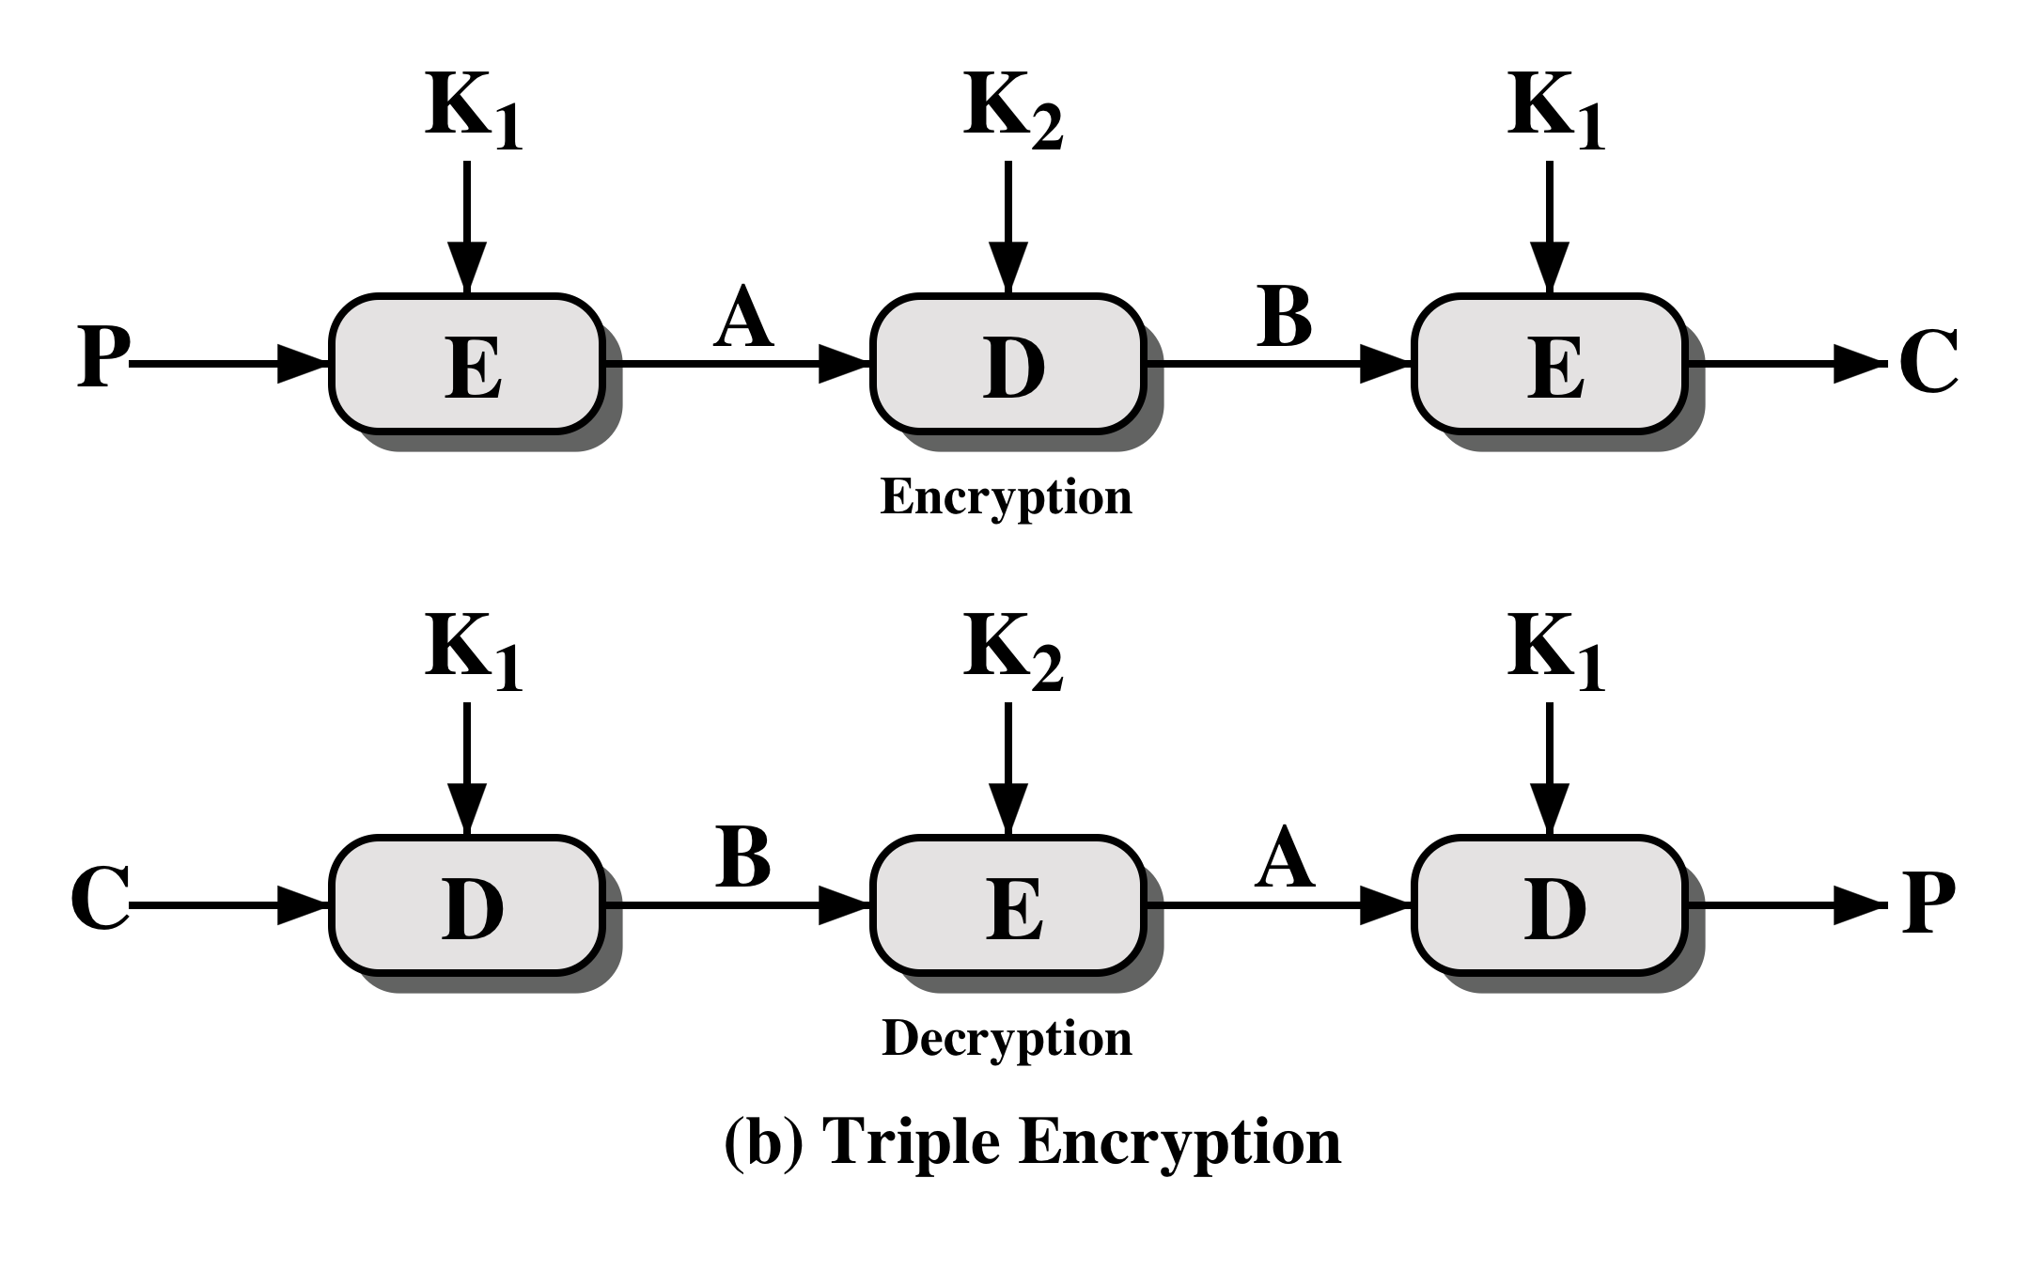
Notes:
The first serious proposal came from Merkle and Hellman [MERK81]. Their
plan involves finding plaintext values that produce a first intermediate value of
A = 0 (Figure 7.1b) and then using the meet-in-the-middle attack to determine
the two keys. The level of effort is 2⁵⁶ , but the technique requires 2⁵⁶ chosen plaintext–
ciphertext pairs, which is a number unlikely to be provided by the holder of
the keys.
A known-plaintext attack is outlined in [VANO90]. This method is an improvement
over the chosen-plaintext approach but requires more effort. The attack
is based on the observation that if we know A and C (Figure 7.1b), then the problem
reduces to that of an attack on double DES. Of course, the attacker does not know
A , even if P and C are known, as long as the two keys are unknown. However, the
attacker can choose a potential value of A and then try to find a known (P , C ) pair
that produces A .

Slide 7
Triple DES with Three Keys
Many researchers now feel that three-key 3DES is the preferred alternative
A number of Internet-based applications have adopted three-key 3DES including PGP and S/MIME
Three-key 3DES has an effective key length of 168 bits and is defined as:
C = E( K₃, D( K₂, E( K₁, P)))
Backward compatibility with DES is provided by putting:
K₃ = K₂ or K₁ = K₂
Notes:
Although the attacks just described appear impractical, anyone using two-key 3DES
may feel some concern. Thus, many researchers now feel that three-key 3DES is
the preferred alternative (e.g., [KALI96a]). Three-key 3DES has an effective key
length of 168 bits and is defined as
C = E( K₃, D( K₂, E( K₁, P)))
Backward compatibility with DES is provided by putting
K₃ = K₂ or K₁ = K₂
A number of Internet-based applications have adopted three-key 3DES, including
PGP and S/MIME, both discussed in Chapter 19.

Slide 8
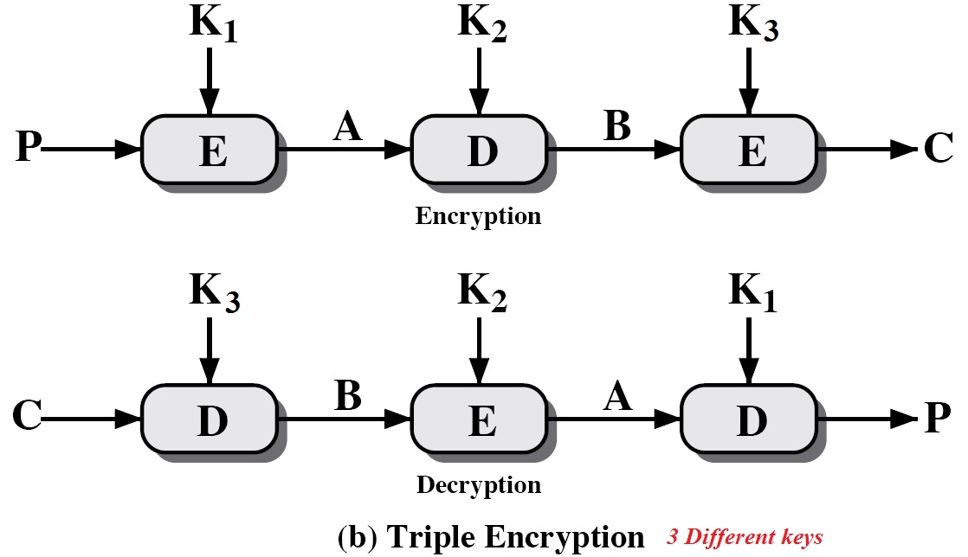
Triple DES with Three Keys .. continue

Slide 9
Modes of Operation
A technique for enhancing the effect of a cryptographic algorithm or adapting the algorithm for an application
To apply a block cipher in a variety of applications, five modes of operation have been defined by NIST
The five modes are intended to cover a wide variety of applications of encryption for which a block cipher could be used
These modes are intended for use with any symmetric block cipher, including triple DES and AES
Notes:
A block cipher takes a fixed-length block of text of length b bits and a key as input
and produces a b -bit block of ciphertext. If the amount of plaintext to be encrypted
is greater than b bits, then the block cipher can still be used by breaking the plaintext
up into b -bit blocks. When multiple blocks of plaintext are encrypted using the
same key, a number of security issues arise. To apply a block cipher in a variety of
applications, five modes of operation have been defined by NIST (SP 800-38A).
In essence, a mode of operation is a technique for enhancing the effect of a cryptographic
algorithm or adapting the algorithm for an application, such as applying
a block cipher to a sequence of data blocks or a data stream. The five modes are
intended to cover a wide variety of applications of encryption for which a block
cipher could be used. These modes are intended for use with any symmetric block
cipher, including triple DES and AES.

Slide 10
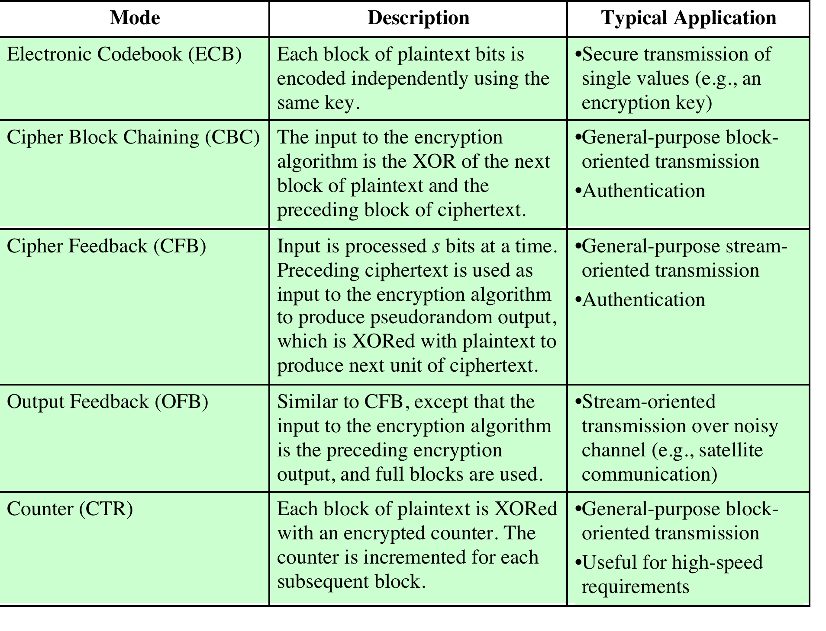
Notes:
The modes are summarized in Table 7.1 and described in this and the following sections.

Slide 11
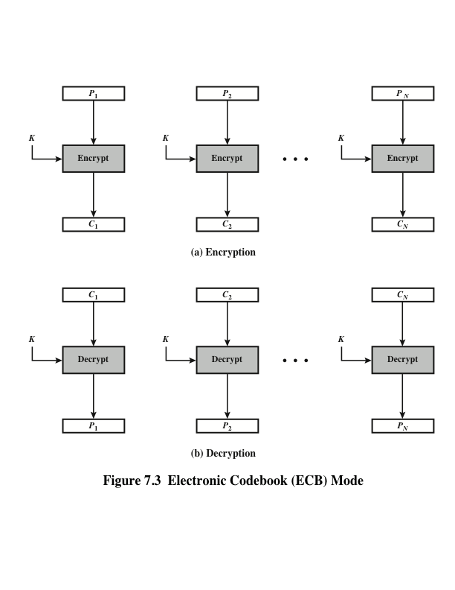
Notes:
The simplest mode is the electronic codebook (ECB ) mode, in which plaintext
is handled one block at a time and each block of plaintext is encrypted using the
same key (Figure 7.3). The term codebook is used because, for a given key, there is
a unique ciphertext for every b -bit block of plaintext. Therefore, we can imagine a
gigantic codebook in which there is an entry for every possible b -bit plaintext pattern
showing its corresponding ciphertext.
For a message longer than b bits, the procedure is simply to break the message
into b -bit blocks, padding the last block if necessary. Decryption is performed one
block at a time, always using the same key. In Figure 7.3, the plaintext (padded as
necessary) consists of a sequence of b -bit blocks, P₁ , P₂ , . . . , P_{N} ; the corresponding
sequence of ciphertext blocks is C₁ , C₂ , . . . , C_{N} . We can define ECB mode as
follows.
ECB C_{j} = E(K, Pj) j = 1, . . . , N P_{j} = D(K, Cj₎ j = 1, . . . , N
The ECB method is ideal for a short amount of data, such as an encryption
key. Thus, if you want to transmit a DES or AES key securely, ECB is the appropriate
mode to use.
The most significant characteristic of ECB is that if the same b -bit block of
plaintext appears more than once in the message, it always produces the same
ciphertext.
For lengthy messages, the ECB mode may not be secure. If the message is
highly structured, it may be possible for a cryptanalyst to exploit these regularities.
For example, if it is known that the message always starts out with certain
predefined fields, then the cryptanalyst may have a number of known plaintext–
ciphertext pairs to work with. If the message has repetitive elements with a
period of repetition a multiple of b bits, then these elements can be identified by the
analyst. This may help in the analysis or may provide an opportunity for substituting
or rearranging blocks.

Slide 12
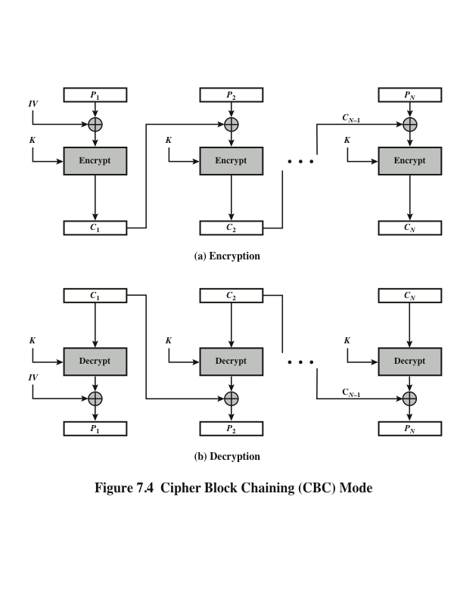
Notes:
To overcome the security deficiencies of ECB, we would like a technique in which
the same plaintext block, if repeated, produces different ciphertext blocks. A
simple way to satisfy this requirement is the cipher block chaining (CBC ) mode
(Figure 7.4). In this scheme, the input to the encryption algorithm is the XOR of the
current plaintext block and the preceding ciphertext block; the same key is used for
each block. In effect, we have chained together the processing of the sequence of
plaintext blocks. The input to the encryption function for each plaintext block bears
no fixed relationship to the plaintext block. Therefore, repeating patterns of b bits
are not exposed. As with the ECB mode, the CBC mode requires that the last block
be padded to a full b bits if it is a partial block.
For decryption, each cipher block is passed through the decryption algorithm.
The result is XORed with the preceding ciphertext block to produce the plaintext
block.
To produce the first block of ciphertext, an initialization vector (IV) is XORed
with the first block of plaintext. On decryption, the IV is XORed with the output
of the decryption algorithm to recover the first block of plaintext. The IV is a data
block that is the same size as the cipher block.
The IV must be known to both the sender and receiver but be unpredictable
by a third party. In particular, for any given plaintext, it must not be possible to
predict the IV that will be associated to the plaintext in advance of the generation
of the IV. For maximum security, the IV should be protected against unauthorized
changes. This could be done by sending the IV using ECB encryption. One reason
for protecting the IV is as follows: If an opponent is able to fool the receiver into
using a different value for IV, then the opponent is able to invert selected bits in the
first block of plaintext.
So long as it is unpredictable, the specific choice of IV is unimportant.
SP800-38A recommends two possible methods: The first method is to apply the
encryption function, under the same key that is used for the encryption of the plaintext,
to a nonce . The nonce must be a data block that is unique to each execution of
the encryption operation. For example, the nonce may be a counter, a timestamp, or
a message number. The second method is to generate a random data block using a
random number generator.
In conclusion, because of the chaining mechanism of CBC, it is an appropriate
mode for encrypting messages of length greater than b bits.
In addition to its use to achieve confidentiality, the CBC mode can be used for
authentication. This use is described in Chapter 12.

Slide 13
Summary
Multiple encryption and triple DES
Double DES
Triple DES with two keys
Triple DES with three keys
Electronic codebook
Cipher block chaining mode
Format-preserving encryption
Motivation
Difficulties in designing
Feistel structure
NIST methods
Cipher feedback mode
Output feedback mode
Counter mode
XTS-AES mode for block-oriented storage devices
Tweakable block ciphers
Storage encryption requirements
Operation on a single block
Operation on a sector
Notes:
Chapter 7 summary.

